Slide 1

University of North Texas
CSCE 2110
Foundations of Data Structures
Splay Tree

Slide 2
Contents
Splay tree
insertion
find
deletion
Notes:
天我们要学习一种非常有趣的数据结构——Splay Tree（伸展树）。 这一章主要分为三个部分： 第一，我们会讲它的插入（insertion）； 第二，是查找（find）； 第三，是删除（deletion）。

Slide 3
Contents
Splay tree
insertion
find
deletion
running time analysis Binary Trees

Slide 4
Self adjusting Trees
Ordinary binary search trees have no balance conditions
What you get from insertion order is it
Balanced trees like AVL trees enforce a balance condition when nodes change
Tree is always balanced after an insert or delete
Self-adjusting trees get reorganized over time as nodes are accessed
Tree adjusts after insert, delete, or find
Notes:
“Self-adjusting Trees”，也就是自调整树。
在普通的 BST 里，树的形状完全取决于插入的顺序。比如，如果我们按升序插入一组数字，那么树就会变成一条“链”一样的结构。
平衡树（Balanced Trees），比如 AVL 树或者红黑树。这类树在节点插入或删除之后，会强制保持树的平衡。举个例子，当你插入一个节点，AVL 树会检测平衡因子，如果不平衡就旋转。所以，不管你插入还是删除，树始终保持平衡，
Self-adjusting Trees（自调整树）。它跟 AVL 不一样，它不会在每次插入或删除后立刻保持平衡，而是在访问节点的时候，自动调整结构，让常访问的节点靠近根部。
换句话说，它更聪明一点——它能根据使用频率动态地重组结构，让你下次访问更快。

Slide 5
Splay Trees
Splay trees are tree structures that:
Are not perfectly balanced all the time
Data most recently accessed is near the root. (principle of locality; 80-20 “rule”)
The procedure:
After node X is accessed, perform “splaying” operations to bring X to the root of the tree.
Do this in a way that leaves the tree more balanced as a whole
Notes:
Splay Tree 则不追求完美平衡。伸展树并不是一直都是完全平衡的， 但它会让最近访问过的节点自动靠近根节点。这样做的好处是：根据“局部性原理（principle of locality）”， 我们经常访问的数据往往是最近访问过的那一部分。这就像“80-20 法则”：大部分访问其实集中在少数节点上。所以，如果这些节点靠近根部，我们整体访问效率就能显著提升。
再来说说它的操作过程（the procedure）。每当我们访问一个节点，比如节点 X， 我们就会执行一种叫做 “splaying” 的操作，也就是通过一系列旋转（Zig、Zig-Zig、Zig-Zag）把这个节点 移动到根的位置。

Slide 6
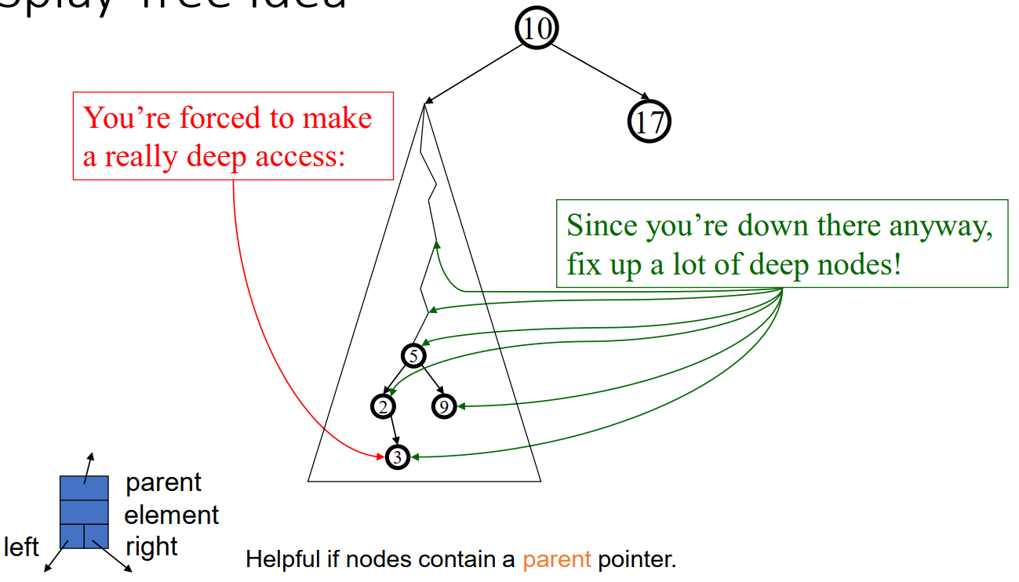
Splay Tree Idea

Slide 7
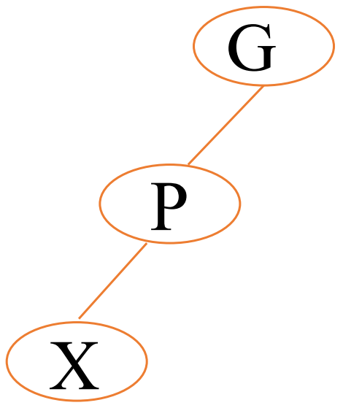
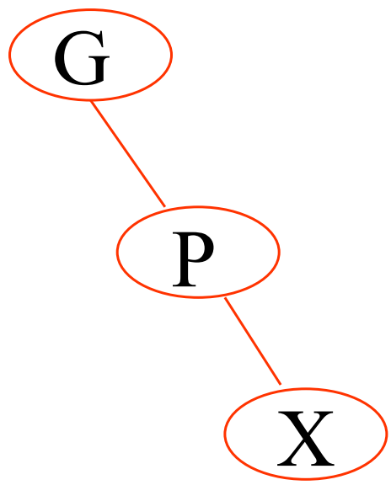
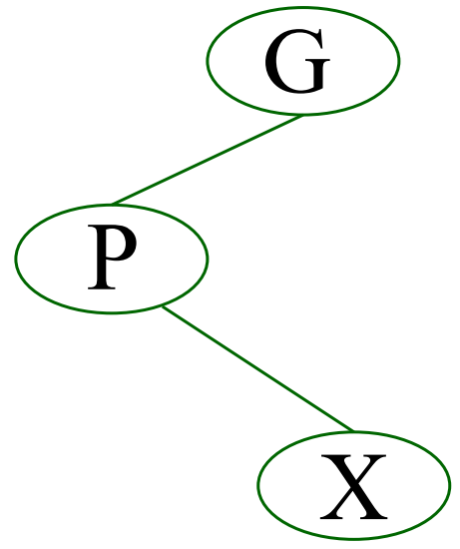
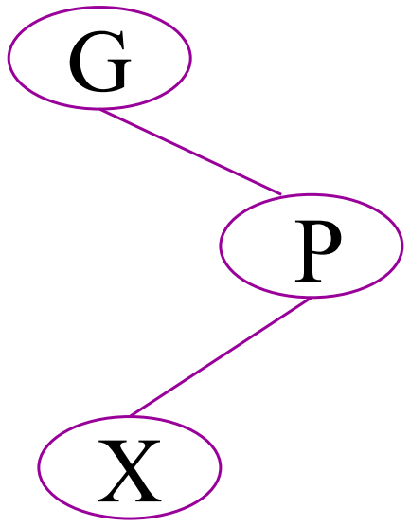
Splaying Cases
Node being accessed (x) is:
Root (no rotation)
Child of root (single rotation)
Has both parent (p) and grandparent (g)
Zig-zig pattern: g → p → x is left-left or right-right (double rotations)
Zig-zag pattern: g → p → x is left-right or right-left (double rotations)
Notes:
第一种情况：x 是根节点（Root）
第二种情况：x 是根的直接子节点（Child of root）
第三种情况：x 既有父节点 (p)，也有祖父节点 (g)

Slide 8
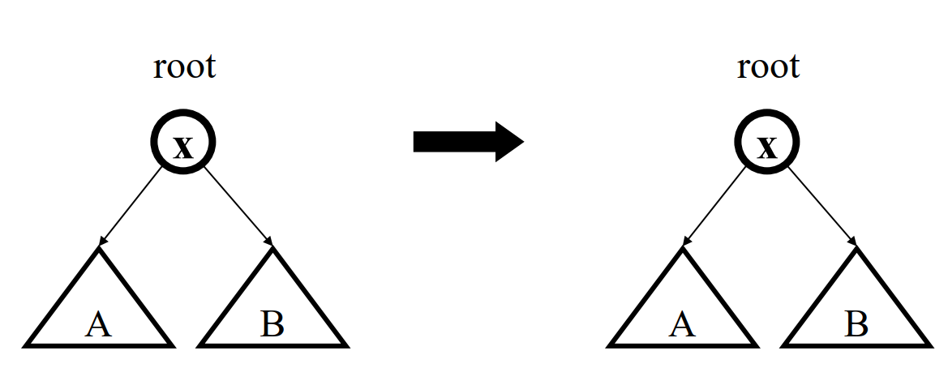
Access Root
Do nothing (that was easy!)
Notes:
当我们访问的节点 x 本身就是根节点（root）。
我们执行 splay 操作的时候，要做什么呢？什么都不用做！因为 splaying 的目标是“把被访问的节点移到根”，而它已经在那儿了，所以直接跳过。

Slide 9
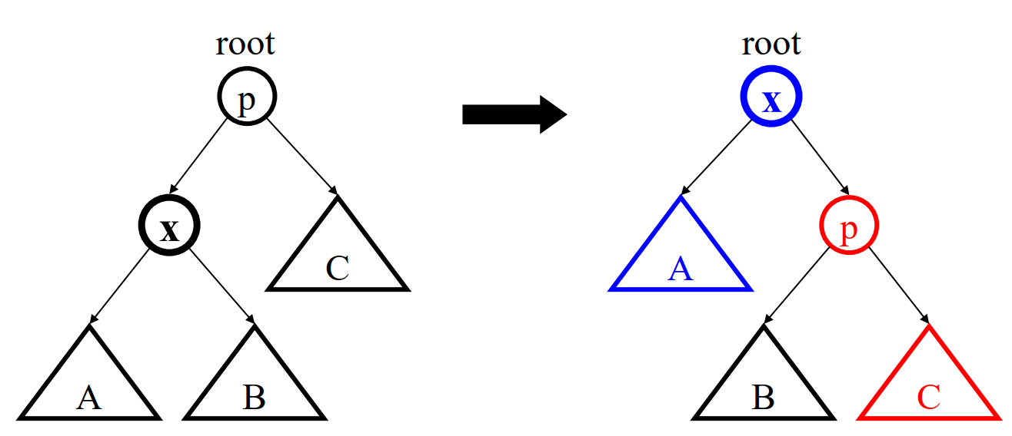
Access Child of Root
Zig (AVL single rotation)
If x is the right child: single left rotation
If x is the left child: single right rotation
Notes:
Zig 的情况，也就是当要访问的节点 x 是根的直接子节点.
我们看到，根节点是 p，它的左孩子是 x。x 的子树是 A 和 B，p 的右子树是 C。
此时我们访问节点 x，根据 splay 的规则，我们要把 x “伸展”到根的位置。怎么做呢？——单旋转（single rotation）。

Slide 10
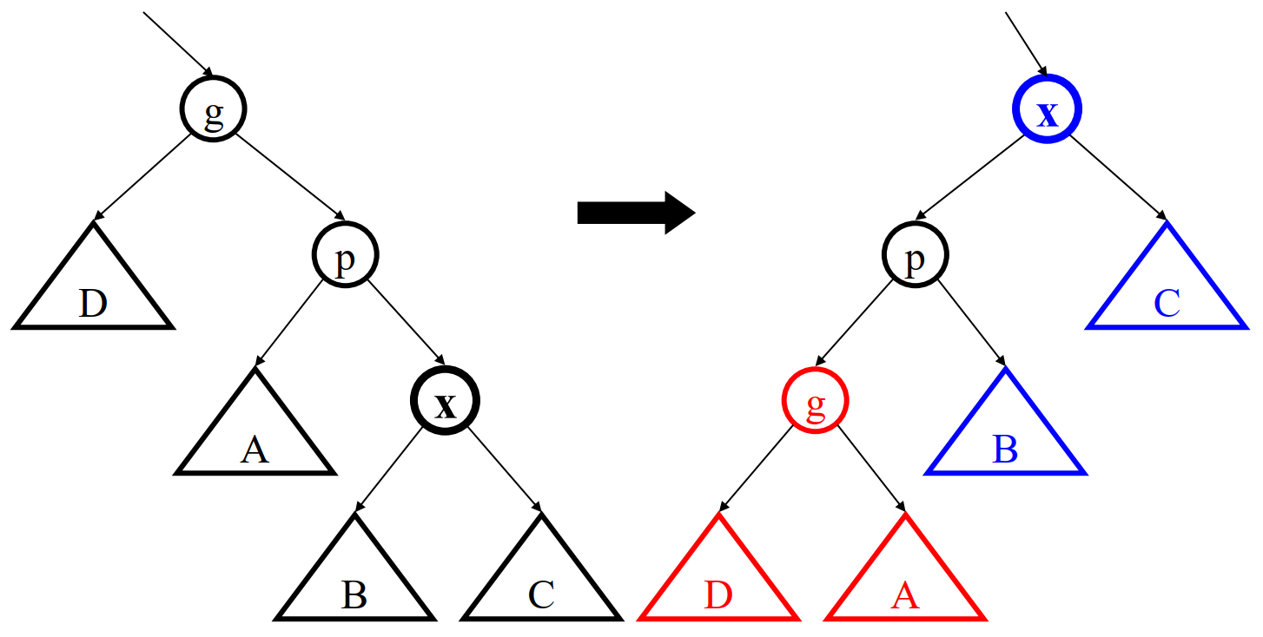
Access (LL, RR) Grandchild
Zig-Zig
Lef—left: two right rotations on x
Right-right: two left rotations on x

Slide 11
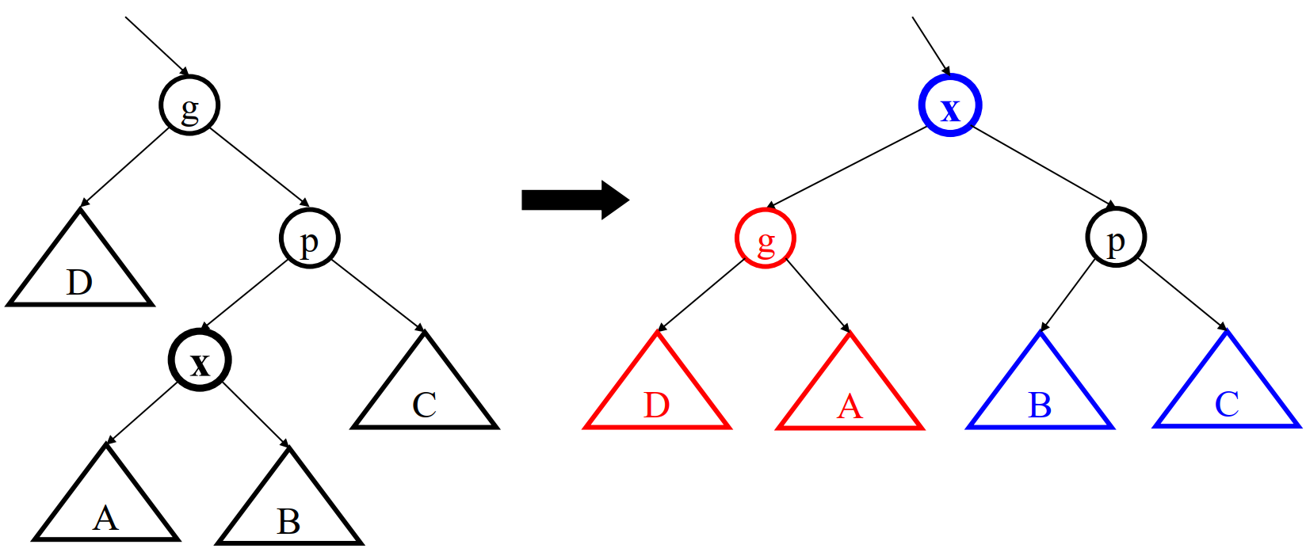
Access (LR, RL) Grandchild
Zig-Zag
Left-right: first left then right rotations on x
Right-left: first right then left rotations on x

Slide 12
Splay Operations: Find
Find the node in normal BST manner
Splay the node to the root

Slide 13
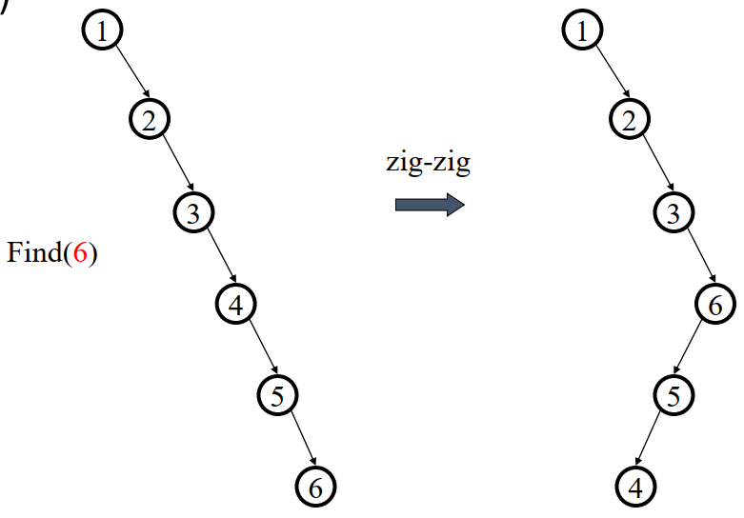
Splaying Example
Find(6)

Slide 14
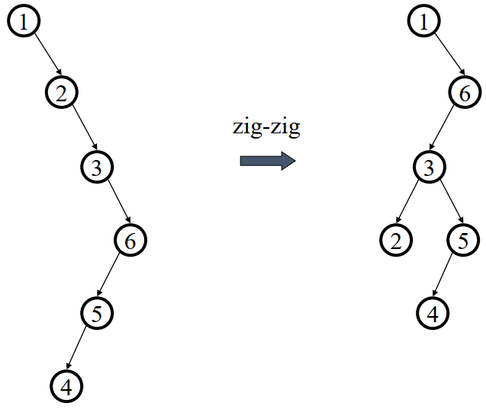
Splaying Example
… still splaying …

Slide 15
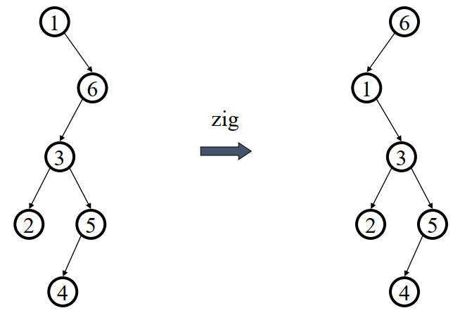
Splaying Example
… 6 splayed out!

Slide 16
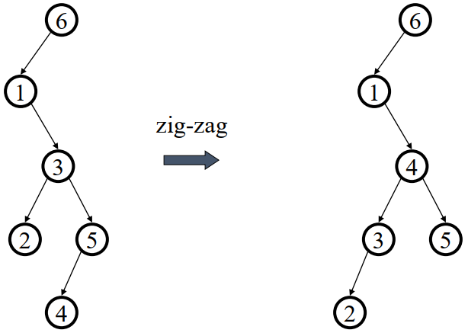
Splaying Example
Find (4)
Splay it Again!

Slide 17
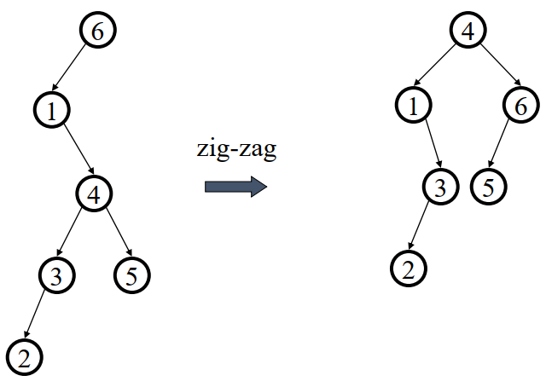
Splaying Example
… 4 splayed out!

Slide 18
Analyzing Calls to a Data Structure
Some algorithms involve repeated calls to one or more data structures
Example:
repeatedly insert keys into a dynamic array
repeatedly remove the smallest key from the heap
When analyzing the running time of the overall algorithm, need to sum up the time spent in all the calls to the data structure
When different calls take different times, how can we accurately calculate the total time?

Slide 19
Amortized Analysis
Purpose is to accurately compute the total time spent in executing a sequence of operations on a data structure
Three different approaches:
aggregate method: brute force
accounting method: assign costs to each operation so that it is easy to sum them up while still ensuring that result is accurate
potential method: a more sophisticated version of the accounting method
In Amortized Analysis, we analyze a sequence of operations and guarantee a worst-case average time which is lower than the worst- case time of a particular expensive operation.

Slide 20
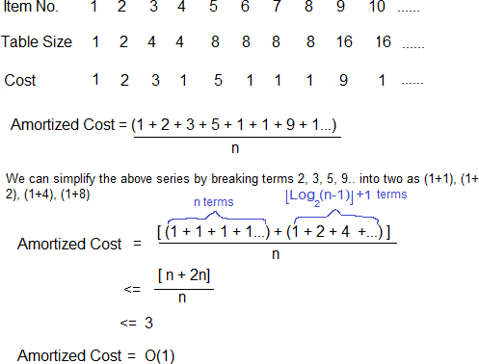
Dynamic Array Insertion

Slide 21
Splay Tree Algorithm Analysis
Worst case time is O(n)
Amortized time for all operations is O(log n)
a sequence of M operations on an n-node splay tree takes O(M log n) time.
Maybe not now, but soon, and for the rest of the operations

Slide 22
Why Splaying Helps
If a node on the access path is at depth 𝑑 before the splay, it’s final depth ≤ 3 + 𝑑/2
Exceptions are the root, the child of the root, and the node splayed
Overall, nodes which are below nodes on the access path tend to move closer to the root

Slide 23
Splay Tree Insert and Delete
Insert x
Insert x as normal then splay x to root.
Delete x
Find x
Splay x to root and remove it
Splay the max in the left subtree to the root
Attach the right subtree to the new root of the left subtree.

Slide 24
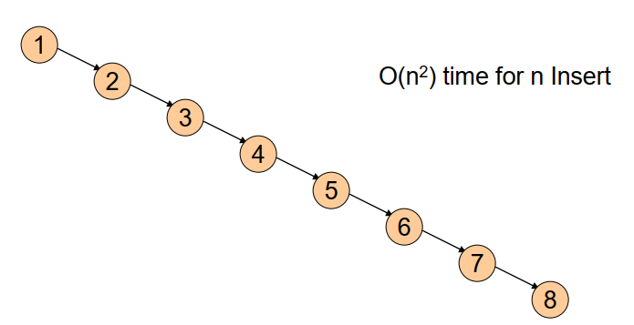
Example Insert
Inserting in order 1, 2, 3, …, 8
Without self-adjustment

Slide 25
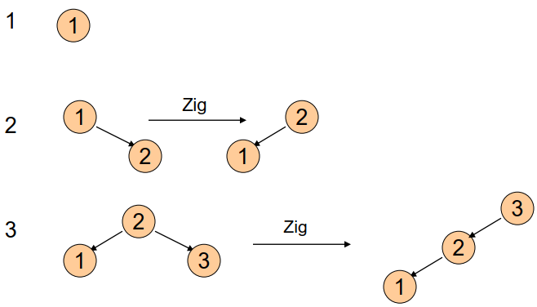
With Self-Adjustment

Slide 26
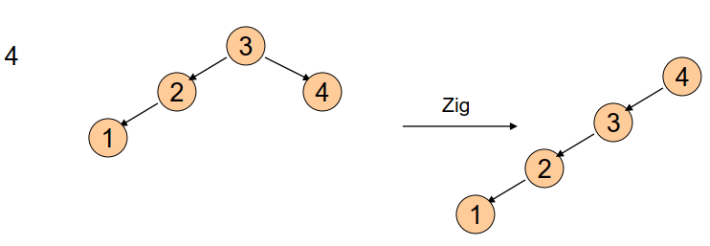
With Self-Adjustment
Each Insert takes O(1) time therefore O(n) time for n Insert!!

Slide 27
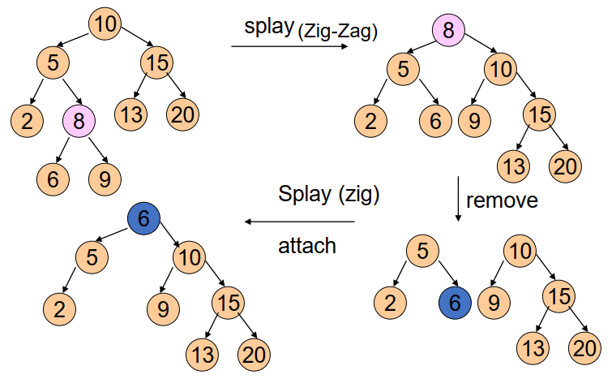
Example Deletion

Slide 28
Summary of Search Trees
Problem with Binary Search Trees: Must keep tree balanced to allow fast access to stored items
AVL trees: Insert/Delete operations keep tree balanced
Splay trees: Repeated Find operations produce balanced trees
Splay trees are very effective search trees
relatively simple: no extra fields required
excellent locality properties:
frequently accessed keys are cheap to find (near top of tree)
infrequently accessed keys stay out of the way (near bottom of tree)

